Slide 1
Megawide Construction Corp. 1H2023 Financial and Operating Results
15 August 2023

Slide 2
DISCLAIMER
This presentation was prepared solely and exclusively for discussion purposes. This presentation and/or any part thereof may not be reproduced, disclosed or used without the prior written consent of Megawide Construction Corporation (the “Company”).
This presentation, as well as discussions arising therefrom, may contain statements relating to future expectations and/or projections of the Company by its management team, with respect to the Company and its portfolio companies. These statements are generally identified by forward-looking words such as “believe”, “plan”, “anticipate”, “continue”, “estimate”, “expect”, “may”, “will”, or other similar words. These statements are: (i) presented on the basis of current assumptions which the company’s management team believes to be reasonable and presumed correct based on available data at the time these were made, (ii) based on assumptions regarding the Company’s present and future business strategies, and the environment in which it will operate in the future, (iii) a reflection of our current views with respect to future events and not a guarantee of future performance, and (iv) subject to certain factors which may cause some or all of the assumptions not to occur or cause actual results to diverge significantly from those projected. Any and all forward looking statements made by the Company or any persons acting on its behalf are deemed qualified in their entirety by these cautionary statements.
This presentation is solely for informational purposes and should in no way be construed as a solicitation or an offer to buy or sell securities or related financial instruments of the Company and/or any of its subsidiaries and/or affiliates.

Slide 3
Outline
Financial Highlights
EPC and PCS
Landport Operations
Key Developments (PH1 Transaction)
Open Forum
1.0
2.0
3.0
4.0
5.0

Slide 4
FINANCIAL HIGHLIGHTS

Slide 5

1H2023 CONSOLIDATED INCOME STATEMENT
In PhP M | 1H2023 | 1H2022 | %
Revenues | 11,160.2 | 7,322.0 | 52%
Construction Operation | 10,969.1 | 7,071.6 | 55%
Landport Operations | 191.1 | 250.4 | -24%
Direct Costs | 9,782.7 | 6,162.4 | 59%
Construction | 9,612.5 | 5,971.6 | 61%
Landport Operations | 170.1 | 190.9 | -11%
Gross Profit | 1,377.5 | 1,159.5 | 19%
Operating Expenses | 711.6 | 442.0 | 61%
Operating Profit | 665.9 | 717.5 | -7%
Other Income / (Expenses) | -285.7 | -294.7 | -3%
Finance Costs | -1,046.4 | -659.8 | 59%
Finance Income | 605.1 | 223.7 | 171%
Others | 155.7 | 141.3 | 10%
Profit / (Loss) Before Tax | 380.3 | 422.8 | -10%
Tax Income (Expense) | 17.7 | 75.3 | -77%
Net Income / (Loss) From Continuing Operations | 362.6 | 347.5 | 4%
Net Income From Discontinued Operations | - | -788.7 | -100%
Net Profit/ (Loss) Attributable To: | 362.6 | -441.1 | -182%
Attributable To Parent | 363.2 | -125.7 | -389%
Non-controlling Interest | -0.6 | -315.5 | -100%
52% Growth in consolidated revenues
P363M Consolidated net income (vs P441M net loss)

Slide 6
MARGIN PERFORMANCE
13% Construction EBITDA margin (vs 11% FY2022)
62% Landport EBITDA margin (vs 28% FY2022)
6% Construction net margin 2Q23 (vs 1% 1Q23)
 | 1H2023 | 1H2022 | FY2022
Gross Profit Margin | 12% | 16% | 13%
Construction | 12% | 16% | 14%
Terminal Operations | 11% | 24% | -
EBITDA Margin | 14% | 24% | 12%
Construction | 13% | 21% | 11%
Terminal Operations | 62% | 62% | 28%
Net Income Margin | 3% | 5% | 19%
Construction | 4% | 5% | -
Terminal Operations | -44% | -10% | -

Slide 7
BALANCE SHEET HIGHLIGHTS
 | June 30, 2023 | Dec 31, 2022 | % change
Cash & financial assets | 10,199.7 | 15,758.2 | -35.3%
Trade receivables | 22,397.0 | 18,361.0 | 22.0%
Contract Assets | 5,110.9 | 5,106.3 | 0.1%
Other Current Assets | 13,367.4 | 14,569.2 | -8.2%
Total Current Assets | 51,075.1 | 53,794.7 | -5.1%
Property, Plant &Equipment | 6,245.9 | 6,734.0 | -7.2%
Other non current assets | 6,570.8 | 5,924.0 | 10.9%
TOTAL ASSETS | 63,891.7 | 66,452.7 | -3.9%
Current loans | 15,004.9 | 14,707.8 | 2.0%
Trade payables | 4,520.0 | 5,332.7 | -15.2%
Other current liabilities | 4,728.9 | 3,896.9 | 21.4%
Total Current Liabilities | 24,253.8 | 23,937.4 | 1.3%
Non current loans | 12,866.2 | 13,071.2 | -1.6%
Exchangeable notes | 7,763.2 | 7,763.2 | 0.0%
Other non current liabilities | 2,290.5 | 2,014.1 | 13.7%
TOTAL LIABILITIES | 22,919.9 | 22,848.5 | 0.3%
EQUITY | 16,718.0 | 19,666.9 | -15.0%
Bank D-E Ratio | 1.7 | 1.4 | 18.0%
Net D-E Ratio | 0.8 | 0.6 | 33.3%
P10B Cash and financial assets
1.7x Bank D-E ratio (vs 2.33X covenant)

Slide 8
EPC: Pivoting to infrastructure and cycle-resiliency

Slide 9
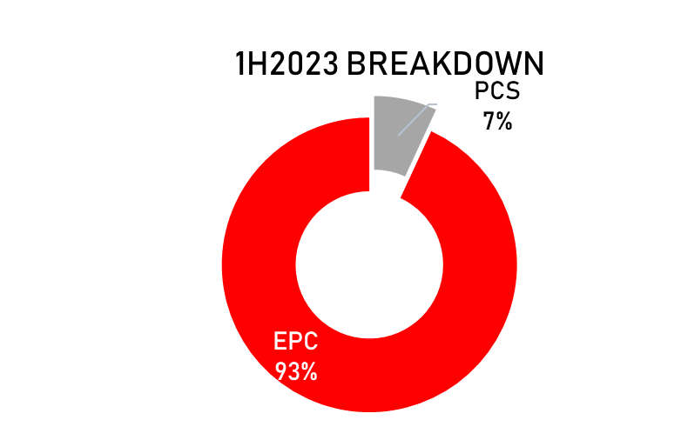
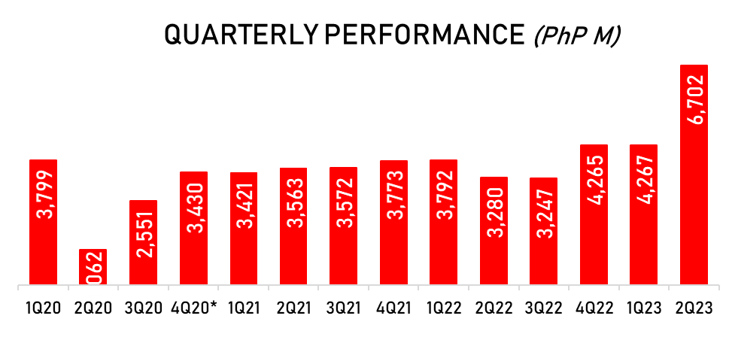
STABLE REVENUE GENERATION
55% 1H2023 revenue growth
P447M 1H23 net income (vs P372M 1H23)
P406M 2Q23 net income (vs P7M 1Q23)
7% PCS share to total (36% external sales)

Slide 10
HEALTHY ORDER BOOK
P50B Order book (3-4 years burn)
22 Existing projects
23% Share of big-ticket infra projects
52% @0-20% completion (for revenue recognition)

Slide 11
Landport Operations

Slide 12

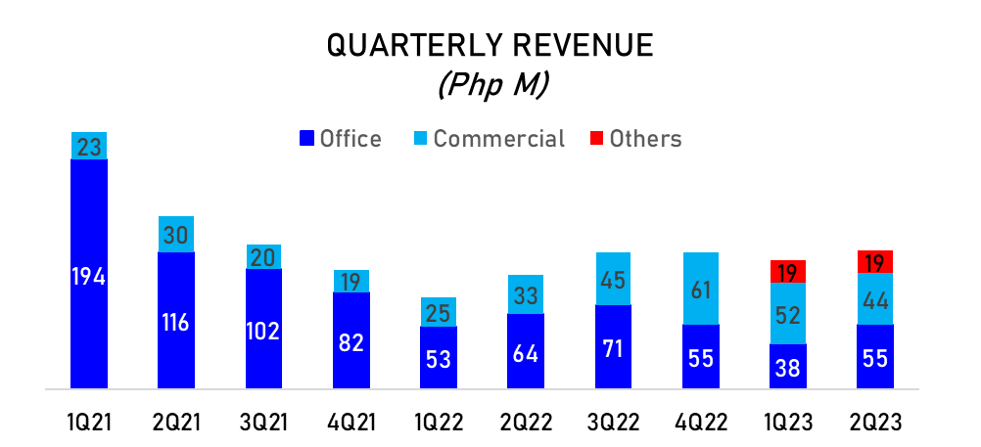
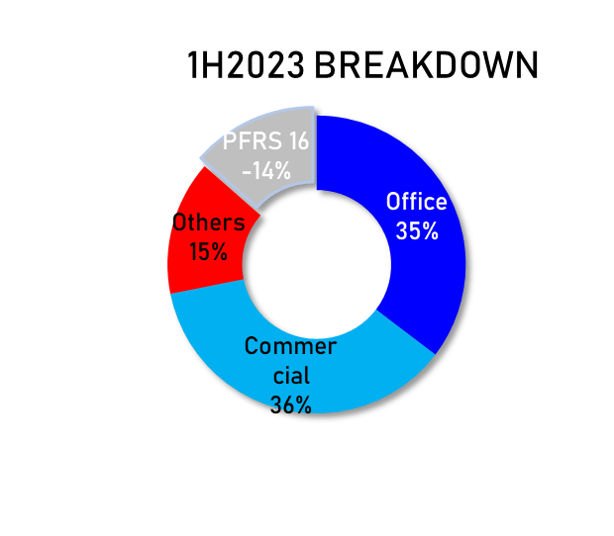
IMPROVING OFFICE SEGMENT
50% commercial 44% 2Q23 vs 57% 1Q23
30% office 36% 2Q23 vs 23% 1Q23
P55M 2Q23 tower revenues (vs P38M 1Q23)
Notes:
P1.85 million remaining balance pertains to construction revenue (PFRS 15)

Slide 13
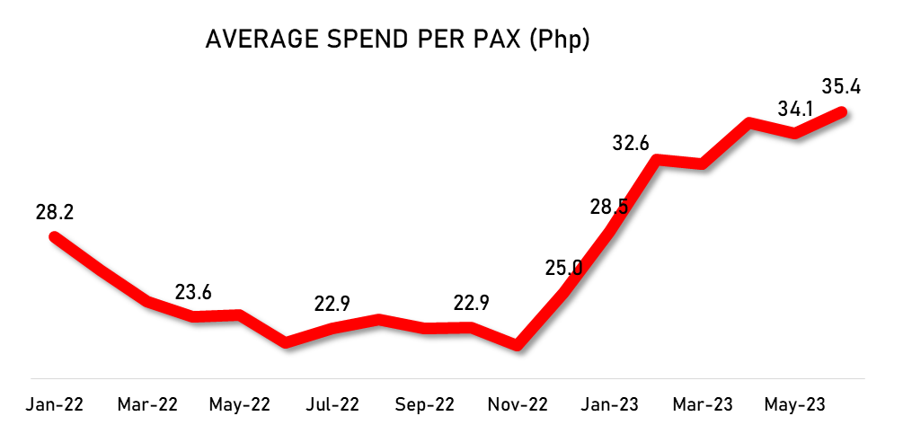
INCREASED TRAFFIC AND PASSENGER SPENDING
101K Daily foot traffic
14 New routes developed (3 new in 2Q23)
P35.4 1H23 average passenger spend
Notes:
P1.85 million remaining balance pertains to construction revenue (PFRS 15)

Slide 14
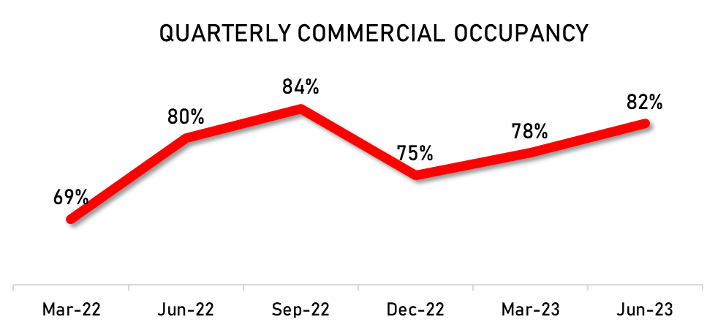
OCCUPANCY STEADILY IMPROVING
82% Commercial area occupancy (from 78%)
55-30-15% F&B – Retail – Services share
60% Office towers occupancy (from 47%)
33% Non-POGO tenants
Notes:
P1.85 million remaining balance pertains to construction revenue (PFRS 15)

Slide 15
Key Developments

Slide 16








Overview
SELLER
TARGET
TRANSACTION
MWIDE to purchase 100% stake (Php5.2 BN) in PH1 World Developers from CHII
Definitive Agreements signed on July 12, 2023, with financial close on July 27, 2023
CITICORE HOLDINGS INVESTMENT, INC.
BUYER

Slide 17




Corporate Structure
PRE-TRANSACTION
POST-TRANSACTION
CITICORE HOLDINGS INVESTMENT, INC.
CITICORE HOLDINGS INVESTMENT, INC.
67%
67%
100%
100%
100%
100%
33.3%
100%
100%
33.3%
100%
100%

Slide 18




A publicly listed diversified engineering conglomerate focused on
CONSTRUCTION and INFRASTRUCTURE DEVELOPMENT
EPC / PRE-CAST & CONSTRUCTION SOLUTIONS
INFRASTRUCTURE INNOVATION
PROPERTY DEVELOPMENT
COMM’L / IND’L
RESIDENTIAL
INFRA
AIRPORT
PUBLIC MARKET
LANDPORT
VERTICAL
HORIZONTAL
PRE CAST & CONST. SOLUTIONS
Pre-Cast
Batching Plant
CELS
Formworks

Slide 19







Investment Rationale
Natural progression and forward integration
Progressive property development
Risk management program
Platform for long-term growth

Slide 20



Natural progression and forward integration
Synergies
Increased Net Income margins
EPC
Pre-Cast Operations
Contractor/ Operator
Property Development
Mid-teens
5-6%
20-25%

Slide 21


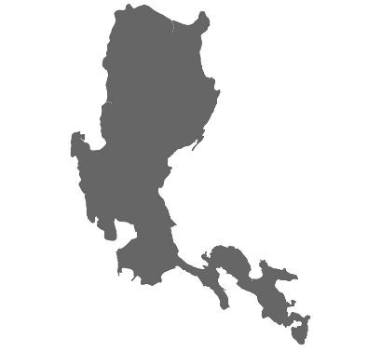
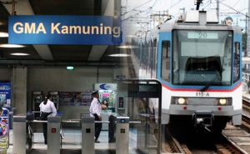
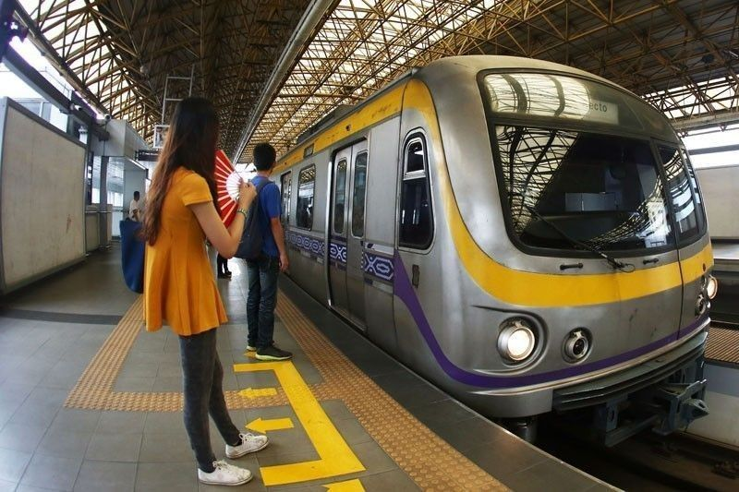


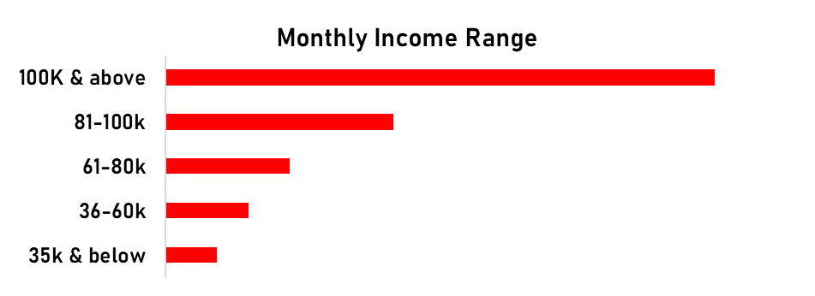
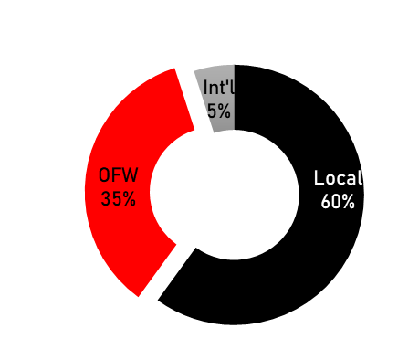
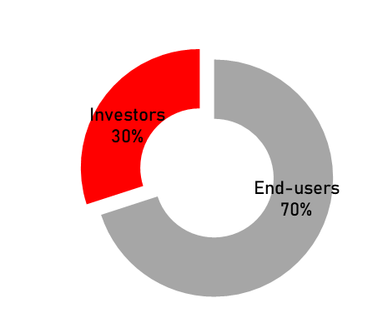
Progressive Property Development
Resilient target market
Transport connectivity
Market belongs to the affordable to mid-income
Early nesters, young professionals, OFWs, and investors.
SJDM
(MRT 7)
Taytay
(MRT 4)
MRT 3
LRT 2
Target Market
Cavite (BRT system)

Slide 22


Risk Management
Reduced counterparty risks
Enhanced project management & efficiency
Contractual disputes
Receivable Issues
Financing platforms

Slide 23
PH1 WORLD DEVELOPERS, INC.

Slide 24
Thank you

Slide 25
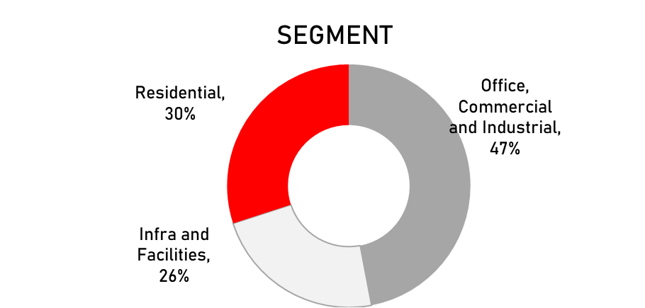
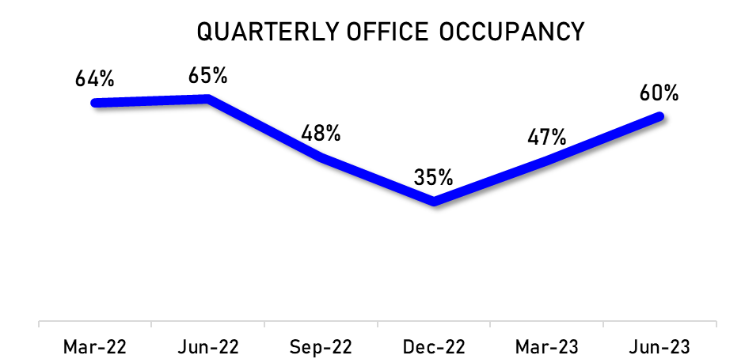
1H 2023 FINANCIAL AND OPERATING HIGHLIGHTS
CONSTRUCTION
LANDPORT
CONSOLIDATED
ORDER BOOK
101K Daily foot traffic
P35.4 1H23 average passenger spend
82% Commercial area occupancy
60% Office towers occupancy
33% Non-POGO tenants
P11.1B 1H2023 consolidated revenues
52% Growth in 1H2023 consolidated revenues
P363M 1H2023 consolidated net income (vs P441M net loss in 1H2022)
1.7x Bank D-E ratio
P10.97B 1H2023 construction revenue
55% 1H2023 revenue growth
P447M 1H23 net income (vs P372M 1H22)
P406M 2Q23 net income (vs P7M 1Q23)
P50B Order book (3-4 years burn)
22 Existing projects
23% Share of big-ticket infra projects
52% @0-20% completion (for revenue recognition)

